Slide 1
PROJ 216 Software Project Concepts
Day 1

Slide 2
Day 1 Agenda
Project Management Concepts
The Request for Proposal
The Proposal
Group Work – start preparing Proposal Presentation for the Travel Experts project

Slide 3
Project management Concepts

Slide 4
Good PM Books at SAIT Library
“Absolute Beginner’s Guide to Project Management” by Greg Horine, 3rd Edition, 2013, QUE, ISBN: 978-0-7897-5010-5
“Information Technology Project management” by Kathy Schwalbe, 2014
“Software Project Management in a Changing World”, by G. Ruhe, and C. Wohlin, 2014 (e-book)

Slide 5
Project Definition
“Project is a finite endeavour (having specific start and completion dates) undertaken to create a unique product or service which brings about beneficial change or added value”
Contrast with Process: “Permanent or semi-permanent functional work to repetitively produce the same product or service”
http://en.wikipedia.org/wiki/Project_management

Slide 6
Projects vs. Processes - Similarities*
Planned, executed and controlled
Performed by people
Resource constrained
* G. Horine – “Project Management: Absolute Beginner Guide”

Slide 7
Projects vs. Processes - Differences*
Feature | Projects | Processes
Purpose | Attain objectives and terminate | Sustain organization
Time | Temporary; defined start and end | Ongoing
Outcome | Unique product, service or result | Multiple products, services or results
People | Temporary teams; not aligned with organization’s structure | Functional teams aligned with organization’s structure
Authority of Manager | Varies by organization Minimal line of authority | Generally formal; direct line of authority
* G. Horine – “Project Management: Absolute Beginner Guide”

Slide 8
Project Characteristics
A set of tasks which may be performed concurrently and/or in sequence, to achieve a goal or objective
A distinct start and finish date
A limited set of resources which may be used on more than one project
Examples of Projects?

Slide 9
Project Goals & Objectives
Goal
End result – what are we trying to accomplish
Objectives
Steps -- how are we going to reach the goal
S = Specific
M = Measurable
A = Achievable (or Agreed-To)
R = Relevant (or: Realistic, Rewarding)
T = Time-bound
Maybe the acronym should be SMAARRRT?

Slide 10
Project Management
“Discipline of planning, organizing, and managing resources to bring about the successful completion of specific project goals and objectives”
http://en.wikipedia.org/wiki/Project_management
Interesting PM statistics:
https://www.planningproapp.com/blog/complete-collection-project-management-statistics-2016/
https://www.wrike.com/blog/complete-collection-project-management-statistics-2015/

Slide 11
Project Management Institute
PMI: www.pmi.org
Certification
PM Body of Knowledge (PMBOK)
A Guide to Project Management Body of Knowledge (PMBOK Guide) 2013 is available at the SAIT Library (e-book)
Code of Ethics
http://www.pmi.org/~/media/PDF/Ethics/ap_pmicodeofethics.ashx

Slide 12
Project Management
Determining Project Success
Achieves desired objectives (Quality) within given deadlines and budget
Meets Requirements
On-Time
Within Budget

Slide 13
Project Management Triangle
Alternate view
Scope/ Quality
Time
Cost

Slide 14
Project Management
Project Manager’s responsibilities
Assigning tasks
Planning & organizing
Supervising

Slide 15
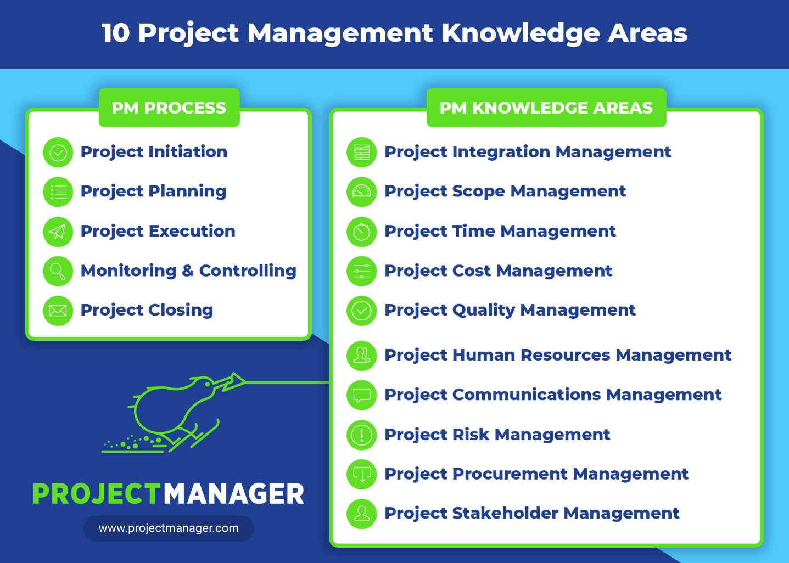
10 Knowledge Areas

Slide 16
Resources: 10 Knowledge Areas
https://blog.masterofproject.com/pmbok-pdf/
https://www.projectmanager.com/blog/10-project-management-knowledge-areas
https://www.workfront.com/blog/10-project-management-knowledge-areas-what-you-need-to-know

Slide 17
コミュ発表
Communications might be paramount as it informs every aspect of the project. Communications inform the team and stakeholders, therefore the need to plan communications management is a critical step in any project.
Define: Com is all about informing the right members on the right time the information they need to know, which includes but not limited to deadlines, required quality, funds, changes.
Why Important?: project nature decides com is important.
Before start: How com is done & What frequency & Who needs What and When
Do not over communicate or under

Slide 18
Exercise
Form 10 groups:
Scope Management
Time Management
Cost Management
Quality Management
Resource Management
Communication Management
Risk Management
Procurement Management
Stakeholder Management
Integration Management

Slide 19
Exercise
Class Research and Discussion Exercise:
20-30 minutes to prepare, 5 minutes presentation
Using a Web browser, Research each of your topics and put together a short presentation for the rest of the class Tell us what the topic is about, why it is important that the project manager is responsible for it, and we will discuss the implications of the responsibility for the success of the project

Slide 20
Project Phases
Four Main Phases:
Project Initiation (Definition)
Project Planning
Project Execution
Project Closure
Usually each phase ends with a Phase Review

Slide 21
Project Initiation
“Starting up”:
Business Case
Feasibility Study
Terms of Reference
Team Job Descriptions

Slide 22
Project Planning
Defining the project
G.Horine, “Absolute Beginner’s Guide to Project Management”, 3rd edition, page 47
Project Definition Document
a.k.a. Project Charter
Required Elements
Optional Elements

Slide 23
Project Execution
Build Deliverables
Monitor and Control
Time
Cost
Change
Risk
Procurement
Communications
Acceptance

Slide 24
Project Closure
Project Closure Report
Acceptance by the customer
Review project completion
Lessons learned

Slide 25
RFP and Proposal
Step 1: Getting the Project

Slide 26
The Request For Proposal (RFP)
Produced after current system is understood and requirements have been gathered
Sent to vendors
Describes situation, expectations, problem to be solved, details of what the vendor is expected to provide
Sets guidelines for proposal structure
Vendor prepares a proposal following guidelines in RFP

Slide 27
The Request for Proposal
http://en.wikipedia.org/wiki/Request_for_Proposal
RFT sample templates:
https://www.pandadoc.com/software-development-proposal-template
http://www.entrepreneur.com/formnet/form/1173
Companies who specialize in custom software development may solicit RFP applications:
https://www.kandasoft.com/RFP-submission.html

Slide 28
The Proposal
Response to an RFP
Must follow the RFP guidelines for format
Makes evaluation of proposals easier if they are consistent in format
May be written as a speculative proposal without an RFP
Internet search: “IT project Proposal”
Writing tips
Sample templates
… take with a grain of salt, customize

Slide 29
The Proposal
Project Name, identification codes, date, etc.
Executive overview
Start & finish dates
Goals/objectives
Scope
Cost estimates
Business justification (your sales pitch – why they should give the project to you)
Information about your company
Team members – biography, or resumé

Slide 30
Group Workshop
Working in your workshop groups, discuss the layout, topics, and business description you will use to create a presentation to the Travel Experts management.
The goal of the presentation is to:
Introduce your team
Propose your solution to their prototype development project
Demonstrate the website you have built to show them your capabilities
Provide an overview of the cost and schedule
Begin working on your presentation

